Slide 1
Diyala university
College of engineering
Department of computer engineering
Second stage
8086 Microprocessor
Assistant lecturer: Abdullah Thaier Abdalsatir

Slide 2
8086
Microprocessor
Instruction Set
3. Logical Instructions
Mnemonics: AND, OR, XOR, TEST, SHR, SHL, RCR, RCL …
71

Slide 3
8086
Microprocessor
Instruction Set
3. Logical Instructions
Mnemonics: AND, OR, XOR, TEST, SHR, SHL, RCR, RCL …
72

Slide 4
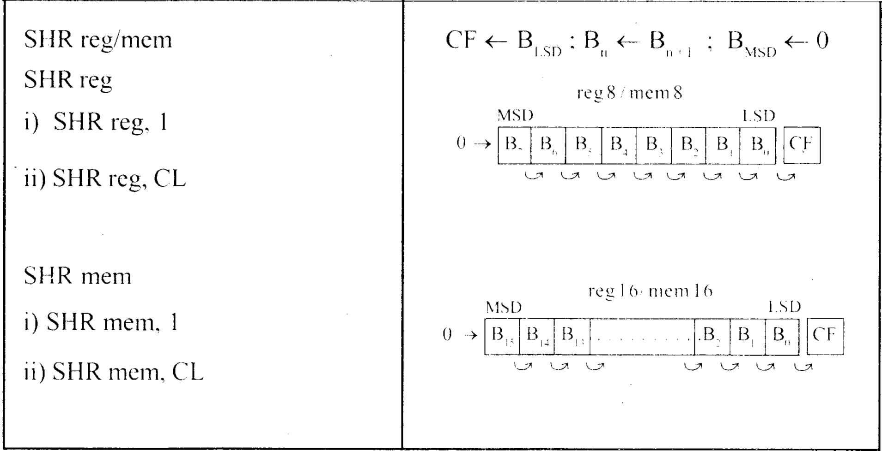
8086
Microprocessor
Instruction Set
3. Logical Instructions
Mnemonics: AND, OR, XOR, TEST, SHR, SHL, RCR, RCL …
73

Slide 5
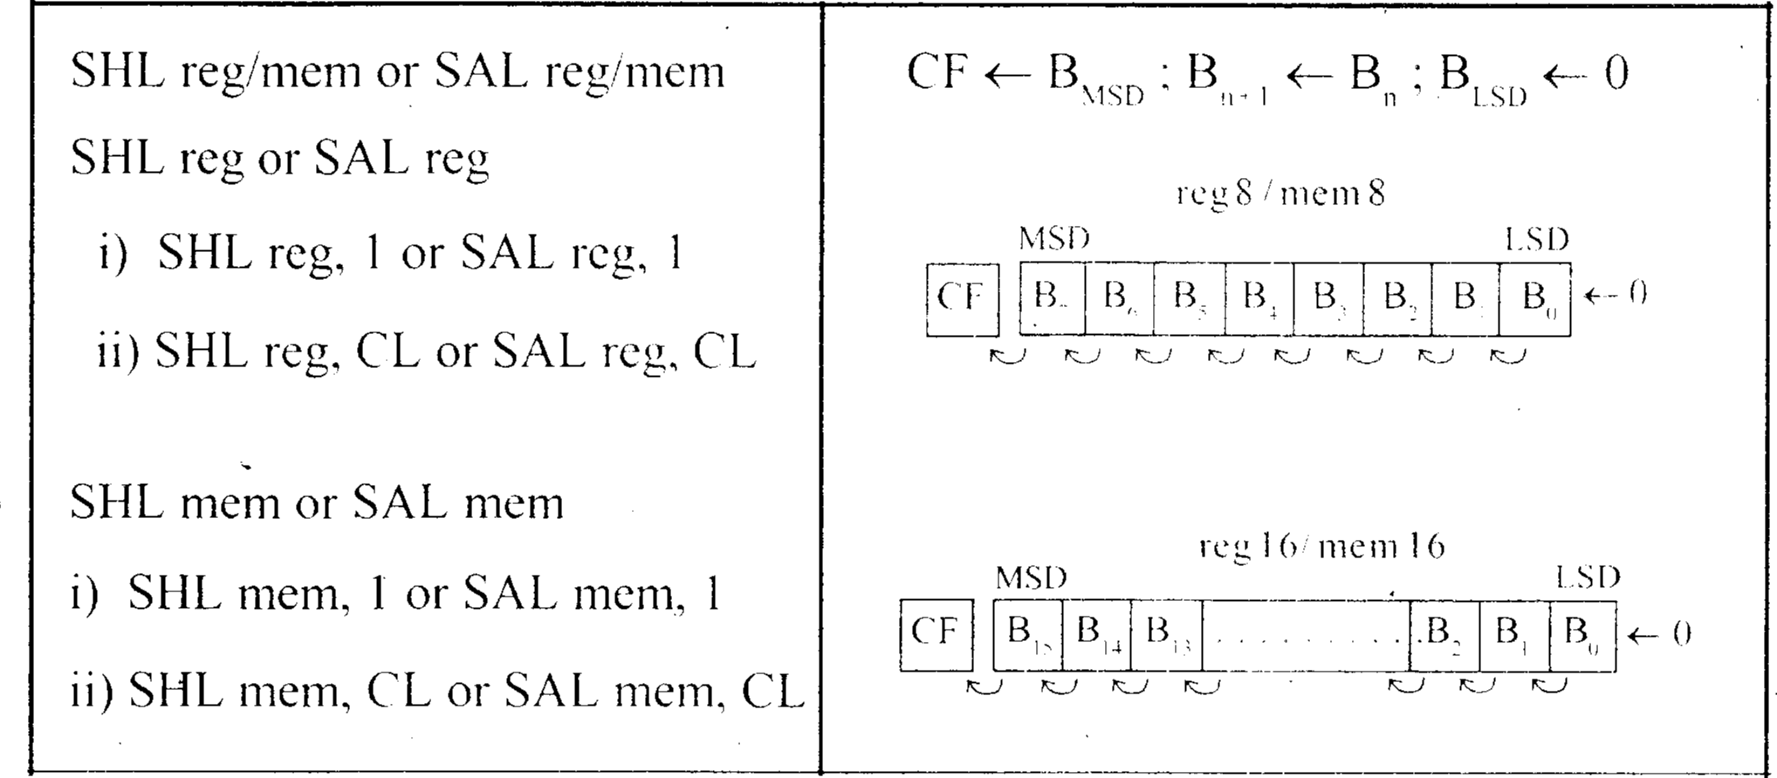
8086
Microprocess
Instruction Set
3. Logical Instructions
Instruction Set
AND, OR, XOR, TEST, SHR, SHL, RCR, RCL
…
74

Slide 6
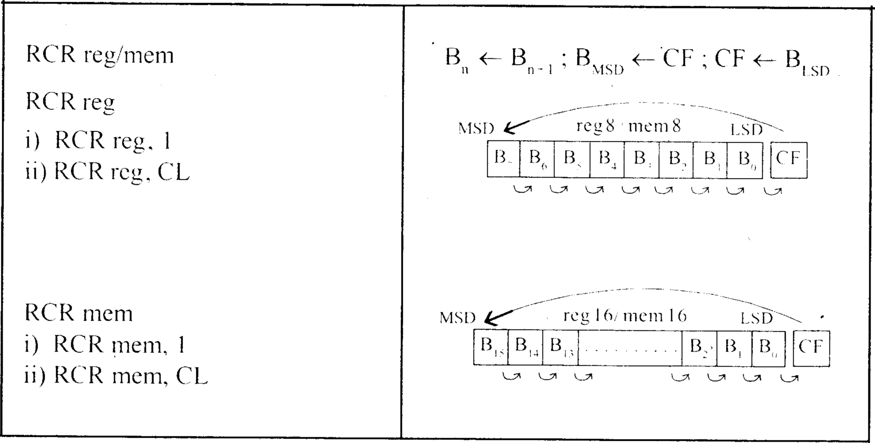
8086
Microprocessor
Instruction Set
3. Logical Instructions
Mnemonics: AND, OR, XOR, TEST, SHR, SHL, RCR, RCL …
75

Slide 7
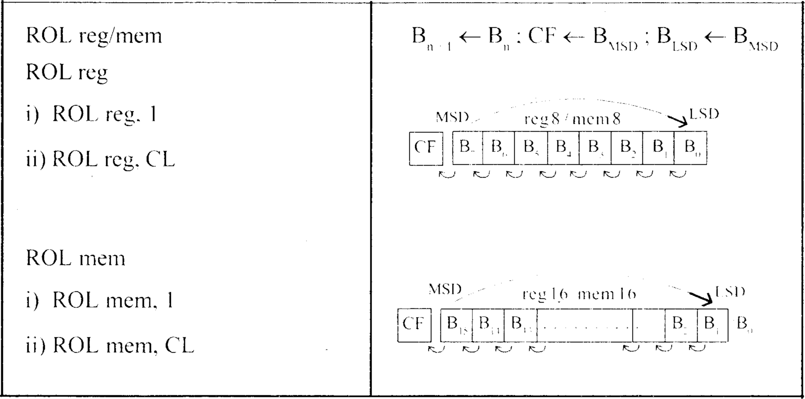
8086
Microprocessor
Instruction Set
3. Logical Instructions
Mnemonics: AND, OR, XOR, TEST, SHR, SHL, RCR, RCL …
76

Slide 8
8086
Microprocessor
Instruction Set
4. String Manipulation Instructions
❑ String : Sequence of bytes or
words
❑ 8086 instruction set includes instruction for string movement, comparison,
scan, load and store.
❑ REP instruction prefix : used to repeat execution of string instructions
❑ String instructions end with S or SB or SW.
S represents string, SB string byte and SW string word.
❑ Offset or effective address of the source operand is stored in SI register and
that of the destination operand is stored in DI register.
❑ Depending on the status of DF, SI and DI registers are automatically
updated.
❑ DF = 0  SI and DI are incremented by 1 for byte and 2 for word.
❑ DF = 1  SI and DI are decremented by 1 for byte and 2 for word.
77

Slide 9
8086
Microprocessor
Instruction Set
4. String Manipulation Instructions
Mnemonics: REP, MOVS, CMPS, SCAS, LODS, STOS
REP
REPZ/ REPE
While CX  0 and ZF = 1, repeat execution of
string instruction and
(Repeat CMPS or SCAS until
(CX)  (CX) – 1
ZF = 0)
REPNZ/ REPNE
While CX  0 and ZF = 0, repeat execution of
string instruction and
(Repeat CMPS or SCAS until
(CX)  (CX) - 1
ZF = 1)
78

Slide 10
8086
Microprocessor
Instruction Set
4. String Manipulation Instructions
Mnemonics: REP, MOVS, CMPS, SCAS, LODS, STOS
MOVS
MOVSB
MA = (DS) x 1610 + (SI)
MAE = (ES) x 1610 + (DI)
(MAE)  (MA)
If DF = 0, then (DI)  (DI) + 1; (SI)  (SI) + 1
If DF = 1, then (DI)  (DI) - 1; (SI)  (SI) - 1
MOVSW
MA = (DS) x 1610 + (SI)
MAE = (ES) x 1610 + (DI)
(MAE ; MAE + 1)  (MA; MA + 1)
If DF = 0, then (DI)  (DI) + 2; (SI)  (SI) + 2
If DF = 1, then (DI)  (DI) - 2; (SI)  (SI) - 2
79

Slide 11
8086
Microprocessor
Instruction Set
4. String Manipulation Instructions
Mnemonics: REP, MOVS, CMPS, SCAS, LODS, STOS
Compare two string byte or string word
CMPS
CMPSB
MA = (DS) x 1610 + (SI)
MAE = (ES) x 1610 + (DI)
Modify flags  (MA) -
(MAE)
If (MA) > (MAE), then CF = 0; ZF = 0; SF = 0
If (MA) < (MAE), then CF = 1; ZF = 0; SF = 1
CMPSW
If (MA) = (MAE), then CF = 0; ZF = 1; SF = 0
For byte operation
If DF = 0, then (DI)  (DI) + 1; (SI)  (SI) + 1
If DF = 1, then (DI)  (DI) - 1; (SI)  (SI) - 1
For word operation
If DF = 0, then (DI)  (DI) + 2; (SI)  (SI) + 2
If DF = 1, then (DI)  (DI) - 2; (SI)  (SI) - 2
80

